Slide 1

Instrumental
Tamara Pavlović

Slide 2
D/L Review
Nouns-Singular- Mascline + neuter– ending u
Nouns- Singular- Feminine Regular and F2- ends in –i
Nouns-Plural- Masculine, Neuter, F2- ending –ima
Nouns- Plural- Feminine- ending –ama
Adjectives- Singular- Masculine and neuter adjectives take –om/em
Adjectives- Singular- Feminine- -oj
Adjectives- Plural- All genders- -im

Slide 3
Change to D/L form and determine the case
1 Govorim o ______________________________________ (moja baba i moj otac).
2 Dajem ove knjige _______________________________ (moji studenti).
3 Mislim o __________________ (on).
4 Kupio je poklon ___________________________ (naši roditelji) .
5 Govorili smo o _________________________________ ( tvoja drugarica Suzana).
6 Davali smo jabuke _______________________________ (dobri ljudi).
7 Mislite o _________________________________ (ova mala deca/djeca).

Slide 4
Change to D/L form and determine the case
1 Govorim o mojoj babi i mom ocu. (L)
2 Dajem ove knjige mojim studentima. (D)
3 Mislim o njemu. (L)
4 Kupio je poklon našim roditeljima. (D)
5 Govorili smo o tvojoj drugarici Suzani. (L)
6 Davali smo jabuke dobrim ljudima. (D)
7 Mislite o ovoj maloj deci. (L)

Slide 5
Instrumental-upotreba
Instrumental Case -Usage

Slide 6
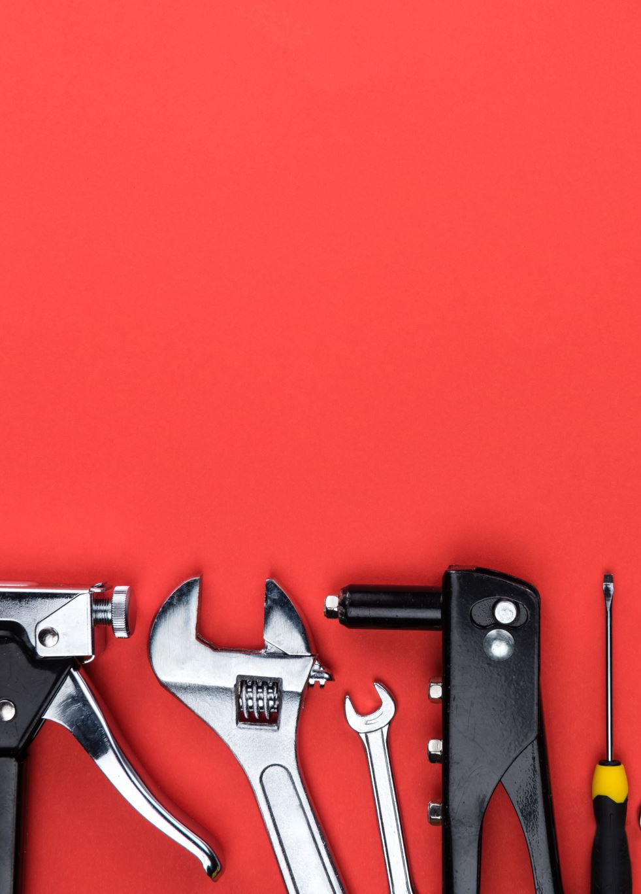
Instrumental without prepositions
The typical BCS instrumental without prepositions is instrumental of means. Since the English equivalents of this BCS usage require preposition “with” or “by” it is VERY important to remember this simple rule:
When a noun in instrumental denotes means, tool or instrument by or with which an action is performed DO NOT USE PREPOSITION S/SA .
I travel by car. Putujem automobilom. (NEVER sa automobilom!!!!)

Slide 7
More examples
I write with a pencil. Pišem olovkom (“olovka” is here an instrument by means of which the subject performs an action)
Jedem viljuškom/vilicom. I eat with a fork.
Pišem desnom rukom. I am right handed (literally: I write with my right arm.)
Žvaćem hranu zubima. I chew food with my teeth.

Slide 8
Series of useful expressions where the Inst. is used without a preposition:
Pisati: olovkom, rukom
Putovati: avionom/zrakoplovom (airplane), vozom/vlakom (train), brodom (boat/ship)
Voziti se (to ride by): autobusem, automobilom, biciklom, tramvajem (streetcar)
Ići (to go by) automobilom, vozom/vlakom, avionom/zrakoplovom
Ići ulicom/cestom (to go along, by the street), obalom reke/rijeke (by the river bank)

Slide 9
examples
Šetati se (to walk, to stroll) ulicama/cestama, parkom, gradom, šumom forest, plažom beach
Javljati se (to inform, to send a word by) telefonom, pismom, mejlom/e-mailom
Baviti se (to be seriously occupied by/involved in) književnošću, slikarstvom painting, sportom, naukom (science and scholarship)

Slide 10

Instrumental Time Expressions
use instrumental singular to render habitual action which you perform on certain days or times:
Ponedeljkom/ponedjeljkom-on Mondays
Praznikom-on holidays
Zorom -at dawn (always at dawn)
Radnim danom- on work days

Slide 11
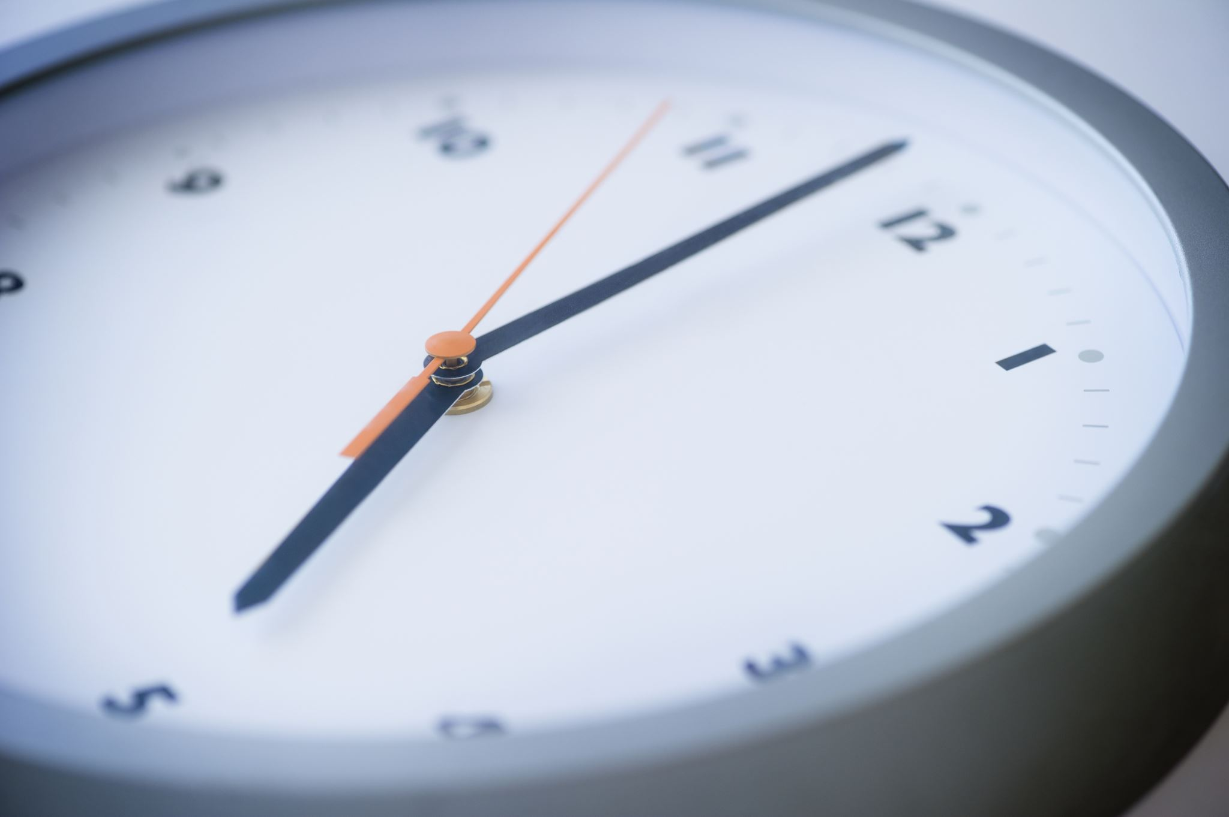
For hours, days, minutes, centuries…
When you want to express a long lasting action extending over many units of the time use instrumental plural:
Satima je pisao. He wrote for hours.
Danima i noćima je učio za ispit. He studied for (many) days and nights for the exam.
Vekovima/vjekovima/stoljećima se taj narod borio za slobodu. For centuries that nation fought for its freedom.

Slide 12
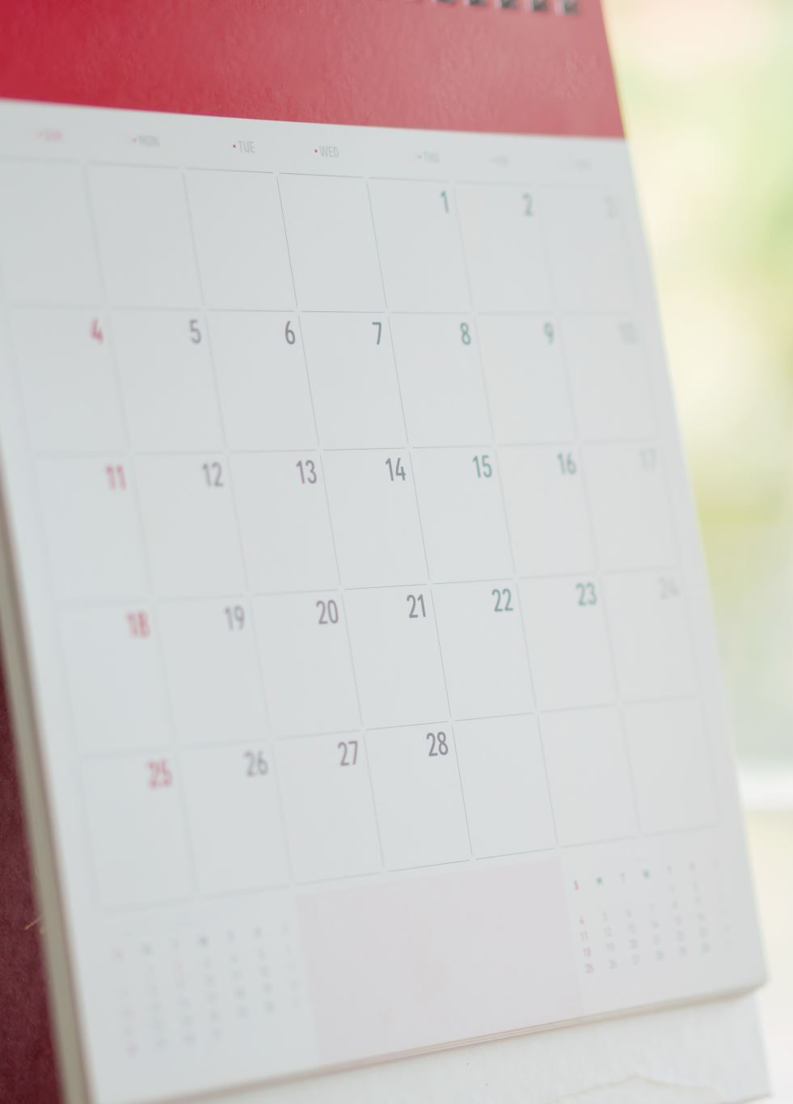
Other examples of these instrumental plural time expresions
Nedeljama/sedmicama for weeks
Mesecima/mjesecima for months
Godinama for years
Vekovima/stoljećima for centuries

Slide 13
Instrumental with prepositions
Where persons or things are regarded as accompanying one another, the preposition s/sa will be used (“s” is the same as “sa” ( fleeting A occurs) however, they are not always interchangeable, so you are always safe if using the full form “sa”).
Igrao sam sa ženom. I danced with my wife. (company)
Učim sa kolegama. I study with my colleagues.
Živim sa majkom i ocem. I live with my mother and father.

Slide 14
Descriptive usage
Žena sa crvenom haljinom ide na koncert. The woman in (with) the red dress goes to the concert.
Čov(j)ek sa plavim očima nas je pratio. The man with blue eyes followed us.
Taj mladić s naočarima/naočalima je dobar. That young man with glasses is nice.

Slide 15
Prepositions nad, pod, pred, za, među
Nad (above), pod (below), pred (in front of), za (behind (if used with instrumental), među (between)
Oblak je nad zgradom. A cloud is above the building.
Pod stolom je olovka. A pencil is under the table.
Pred tobom stojim. I stand in front of you.
Pas ide za nama. A dog is behind us.
Među nama rečeno, on je zao čov(j)ek. Just between us, he is a bad person.

Slide 16
Note on s/sa
These prepositions are interchangeable in most uses. Native speakers avoid using “s” before words beginning with s, š, z, ž because BCS does not tolerate double consonants and its kin/close/related sounds:
Sa sestrom (never s sestrom)
Sa šeširom (never s šeširom)
Sa zvezdom/zvijezdom (never s zvezdom/ zvijezdom)

Slide 17
Instrumental-nastavci
Instrumental Case -Endings

Slide 18
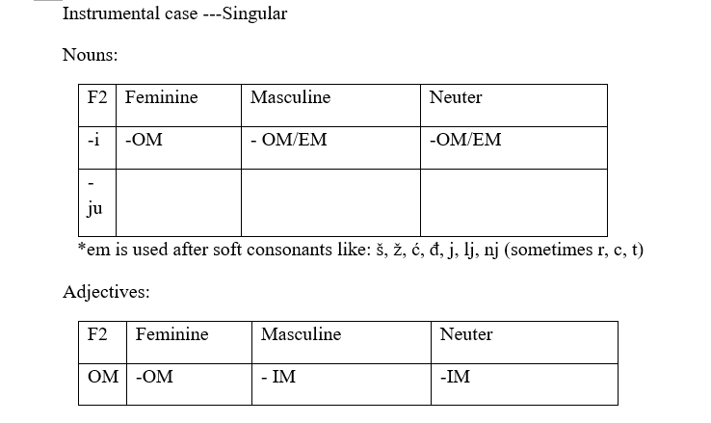

Slide 19
Nouns in singular
masculine and neuter have –om/-em
neuter nouns ending in –o take –om ending:
Nebom, selom, pismom, etc.
Neuter nouns ending in –e take –em:
Poljem, suncem, morem , etc.
Nouns that have extended stem (-en extension) will take -om ending:
vreme/vrijeme in istrumental is vremenom
Ime-in instrumental is imenom

Slide 20
Regular feminin nouns, singular
Ending –om
kafa/kava - kafom/kavom
škola- školom
Knjiga- knjigom

Slide 21
Notes:
Masculine nouns that end in soft palatals j, lj, nj,ć,đ take –em ending:
Kraj –krajem (end)
Kralj-kraljem (king)
Konj-konjem (horse)
Vođ- vođem (old for leader)
Know these examples in section “Notes”!!!

Slide 22
Notes:
Masculine nouns with hard palatals č, ž, š
sometimes take –em sometimes –om
Just remember the following examples:
Miloš- Milošem (Milošom is obsolete typical for epic poetry)
Beč -Bečom Vienna
Mač- mačem (sword)
Nož -nožem (knife)

Slide 23
Notes
Masculine nouns that end in “r” take both –em and –om ending (especially old nouns):
Car- carem (a little older carom) tzar
poštar- poštarem, poštarom postman
Pisar –pisarem, pisarom scribe
Kompozitor- kompozitorem, kompozitorom composer (BS)
But newer nouns can act differently (like to take -om):
Trener -trenerom only (coach)!!!
Bodibilder-bodibilderom (bodybuilder)
Maser-maserom masseur/masseuse
laser- laserom laser

Slide 24
Notes:
Masculine nouns that end in –ac (fleeting A) take -em:
Amerikanac-Amerikancem
Lovac –lovcem hunter
Novac-novcem money
Borac –borcem fighter
Vatrogasac-vatrogascem fireman
Pisac –piscem writer

Slide 25
Notes:
Some masculine nouns that end in S, Z take –both –em and –om :
Nos- nosem (a little older nosom) nose
Mraz- mrazem , mrazom frost
Kurs-kursem, kursom course

Slide 26
Instrumental Singular Review
Režem hleb ….. (nož).
Pišem pismo …… (olovka).
Otvaram vrata ……. (ključ).
Pravimo tortu sa ……… (jaje).

Slide 27
Instrumental Singular Review
Režem hleb nožem.
Pišem pismo olovkom.
Otvaram vrata ključem.
Pravimo tortu sa jajetom.

Slide 28
F2 nouns
Have 2 forms in instrumental singular. The first form ends in –i: noći, ljubavi, krvi, mladosti, jeseni, etc.
The second form ends in –ju. Before –ju all stem final consonants undergo T:Ć alternation in contact with soft –j. The changes occur according to the following table (next slide):

Slide 29
T:Ć alternation
P, B,M, V + J= PLJ, BLJ, MLJ, VLJ (labials)
Krv-krvlju blood
Zob- zoblju oats
L, N + J= LJ, NJ
So/sol- solju salt
Zelen zelenju greenery
T, D +J= Ć,Đ
Pamet- pameću with intelligence
Glad -glađu hunger

Slide 30
F2 ending in –ost and -st
F2 nouns ending in –ost have instrumental ending –ošću:
Mladost-mladošću
Književnost-književnošću
Starost- starošću
Radost-radošću
The same ending is used for F2 nouns ending in –st: mast –mašću (pork lard), vlast-vlašću (the authorities), kost- košću (bones)

Slide 31
Explanation of the process
Consonantal cluster šć is a product of 2 concomitant changes in noun stems ending in -st.
1. First t+j(u) becomes Ć as in radost+j radosću
2. Followed by assimilation of S to Ć by changing into Š :
The final result after 2 alternations is: radošću

Slide 32
If F2 nouns ends in a soft palatal (ć/đ)
If F2 noun ends in a soft palatal –j ending is absorbed by the stem without further change. Only –u ending is seen in the spelling:
Pomoć -pomoću help
Čađ- čađu soot

Slide 33
If F2 noun ends in a hard palatal (r/č)
Or in a consonant not affected by T:Ć alternation the -j is preserved and present in the spelling:
Stvar –stvarju thing
Reč/riječ- rečju, riječju word

Slide 34
Review F2 Singular
Otvorio je vrata ……. (pomoć) ključa.
Sa …………… (književnost) mogu da radim svašta.
Uplašila me je ………. (starost).
Pobedila je ………. (pamet).

Slide 35
Review F2 Singular
Otvorio je vrata pomoću ključa.
Sa književnošću mogu da radim svašta.
Uplašila me je starošću.
Pobedila je pameću.

Slide 36
Nouns in plural
All nouns have instrumental plural identical to their D/L plural forms:
1: masc., neuter and F2 take -ima: prozorima, poljima, ljubavima
2. regular feminine take -ama:lampama, loptama, majkama, sestrama

Slide 37
Put nouns in Instrumental Plural.
Osvetlili su ulice ……….. (lampa).
Uplašili su decu …………. (priča) o duhovima.
Prekrili su put ……….. (znak).
Crtali su ……….. (pero).

Slide 38
Put nouns in Instrumental Plural.
Osvetlili su ulice lampama.
Uplašili su decu pričama o duhovima.
Prekrili su put znakovima.
Crtali su perima.

Slide 39
Adjectives and Pronominal adjectives
All adjectives regardless of gender have instrumental plural forms identical to D/L plural forms: -im:
Dobrim ljudima
Lepim/lijepim poljima
Malim selima
Sjajnim studentima

Slide 40
In the singular
Masculine and neuter adjectives take –im: dobrim ocem, malim selom, velikim pismom
Feminine adjectives take –om ending: lepom/lijepom ženom, velikom loptom, dobrom sestrom.

Slide 41
Put in instrumental
Hvalili su se …….. (visoke plate, pl).
Otišli su sa ……… (širok osmeh, sg).
Uplašili su ih ………… (strašani horori, pl)
Pišem ……… (drevene olovke, pl).

Slide 42
Put in instrumental
Hvalili su se visokim platama.
Otišli su sa širokim osmehom.
Uplašili su ih strašnim hororima.
Pišem drvenim olovkama.

Slide 43
Personal pronouns in instrumental case
Ja -sa mnom
Ti -sa tobom
On/ono- njim/njime (second form more rare)
Ona- njom/njome (second form more rare)
Mi - nama (same as D/L full form)
Vi - vama (same as D/L full form)
Oni, one, ona - njima (same as D/L full form)

Slide 44
Review
Idem sa ……… (ti).
Plačem za ……. (one).
Viđam se sa ………… (on).
Ne uči sa ………. (ja).

Slide 45
Review
Idem sa tobom.
Plačem za njom.
Viđam se sa njim.
Ne uči sa mnom.

Slide 46
For THR
Homework: Instrumental
Ressubmission: Present Tense

